Slide 1


Member Directory
Week 14 - C2C
Report Date: 29 Oct 2026
Total Members: 22
MEMBER DIRECTORY

Slide 2

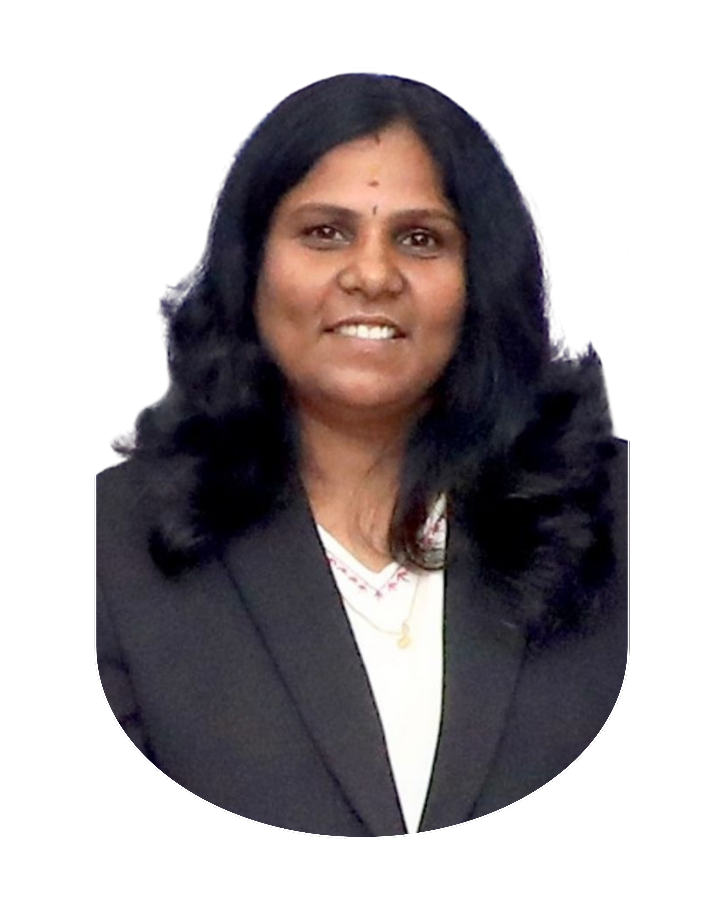
ORCHID BRIDAL STUDIO
JC Nithya Raveendran
📞 9789122775
📍 Perambalur

Slide 3

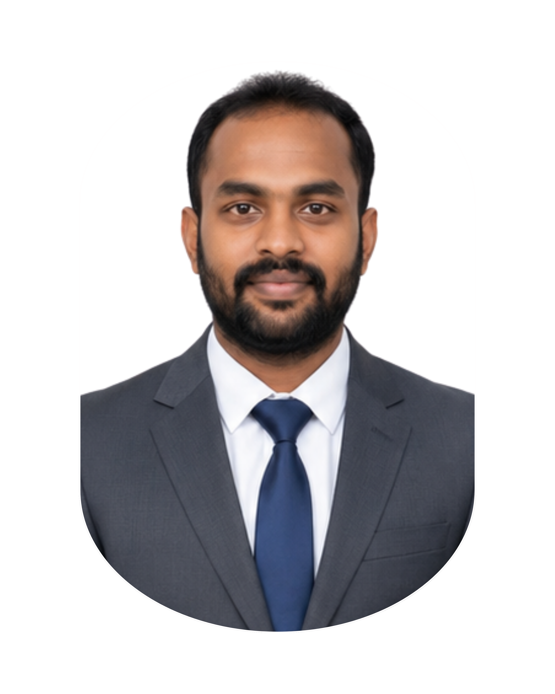
YAALI CONSULTING ENGINEERS
JC Praveenkumar
📞 8667505912
📍 Perambalur

Slide 4

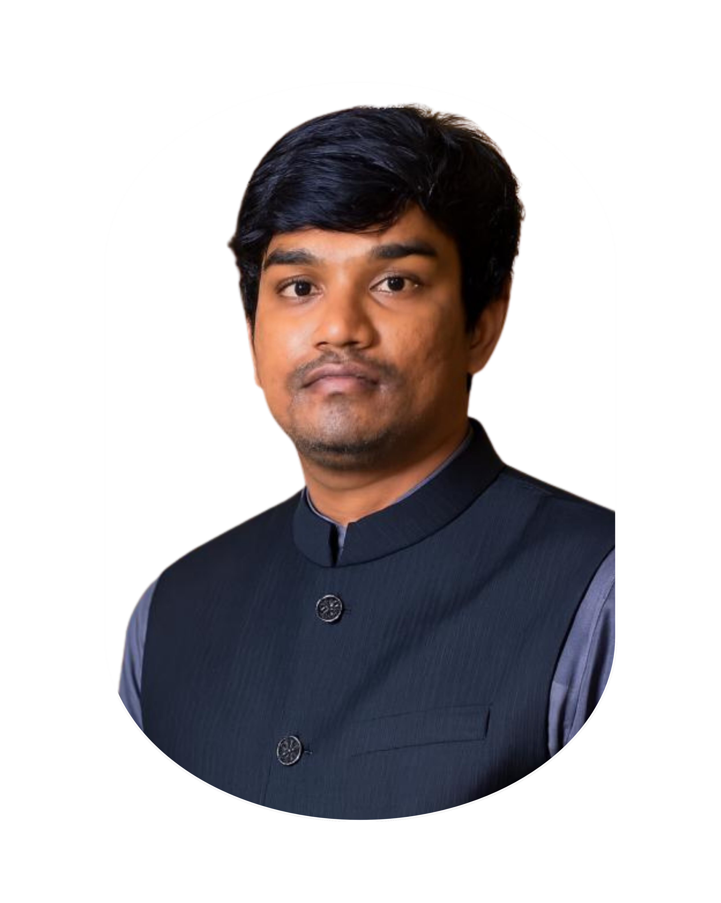
GURUSHASTA INNOTECH
JC Srinath Elangovan
📞 9385894998
📍 Perambalur

Slide 5

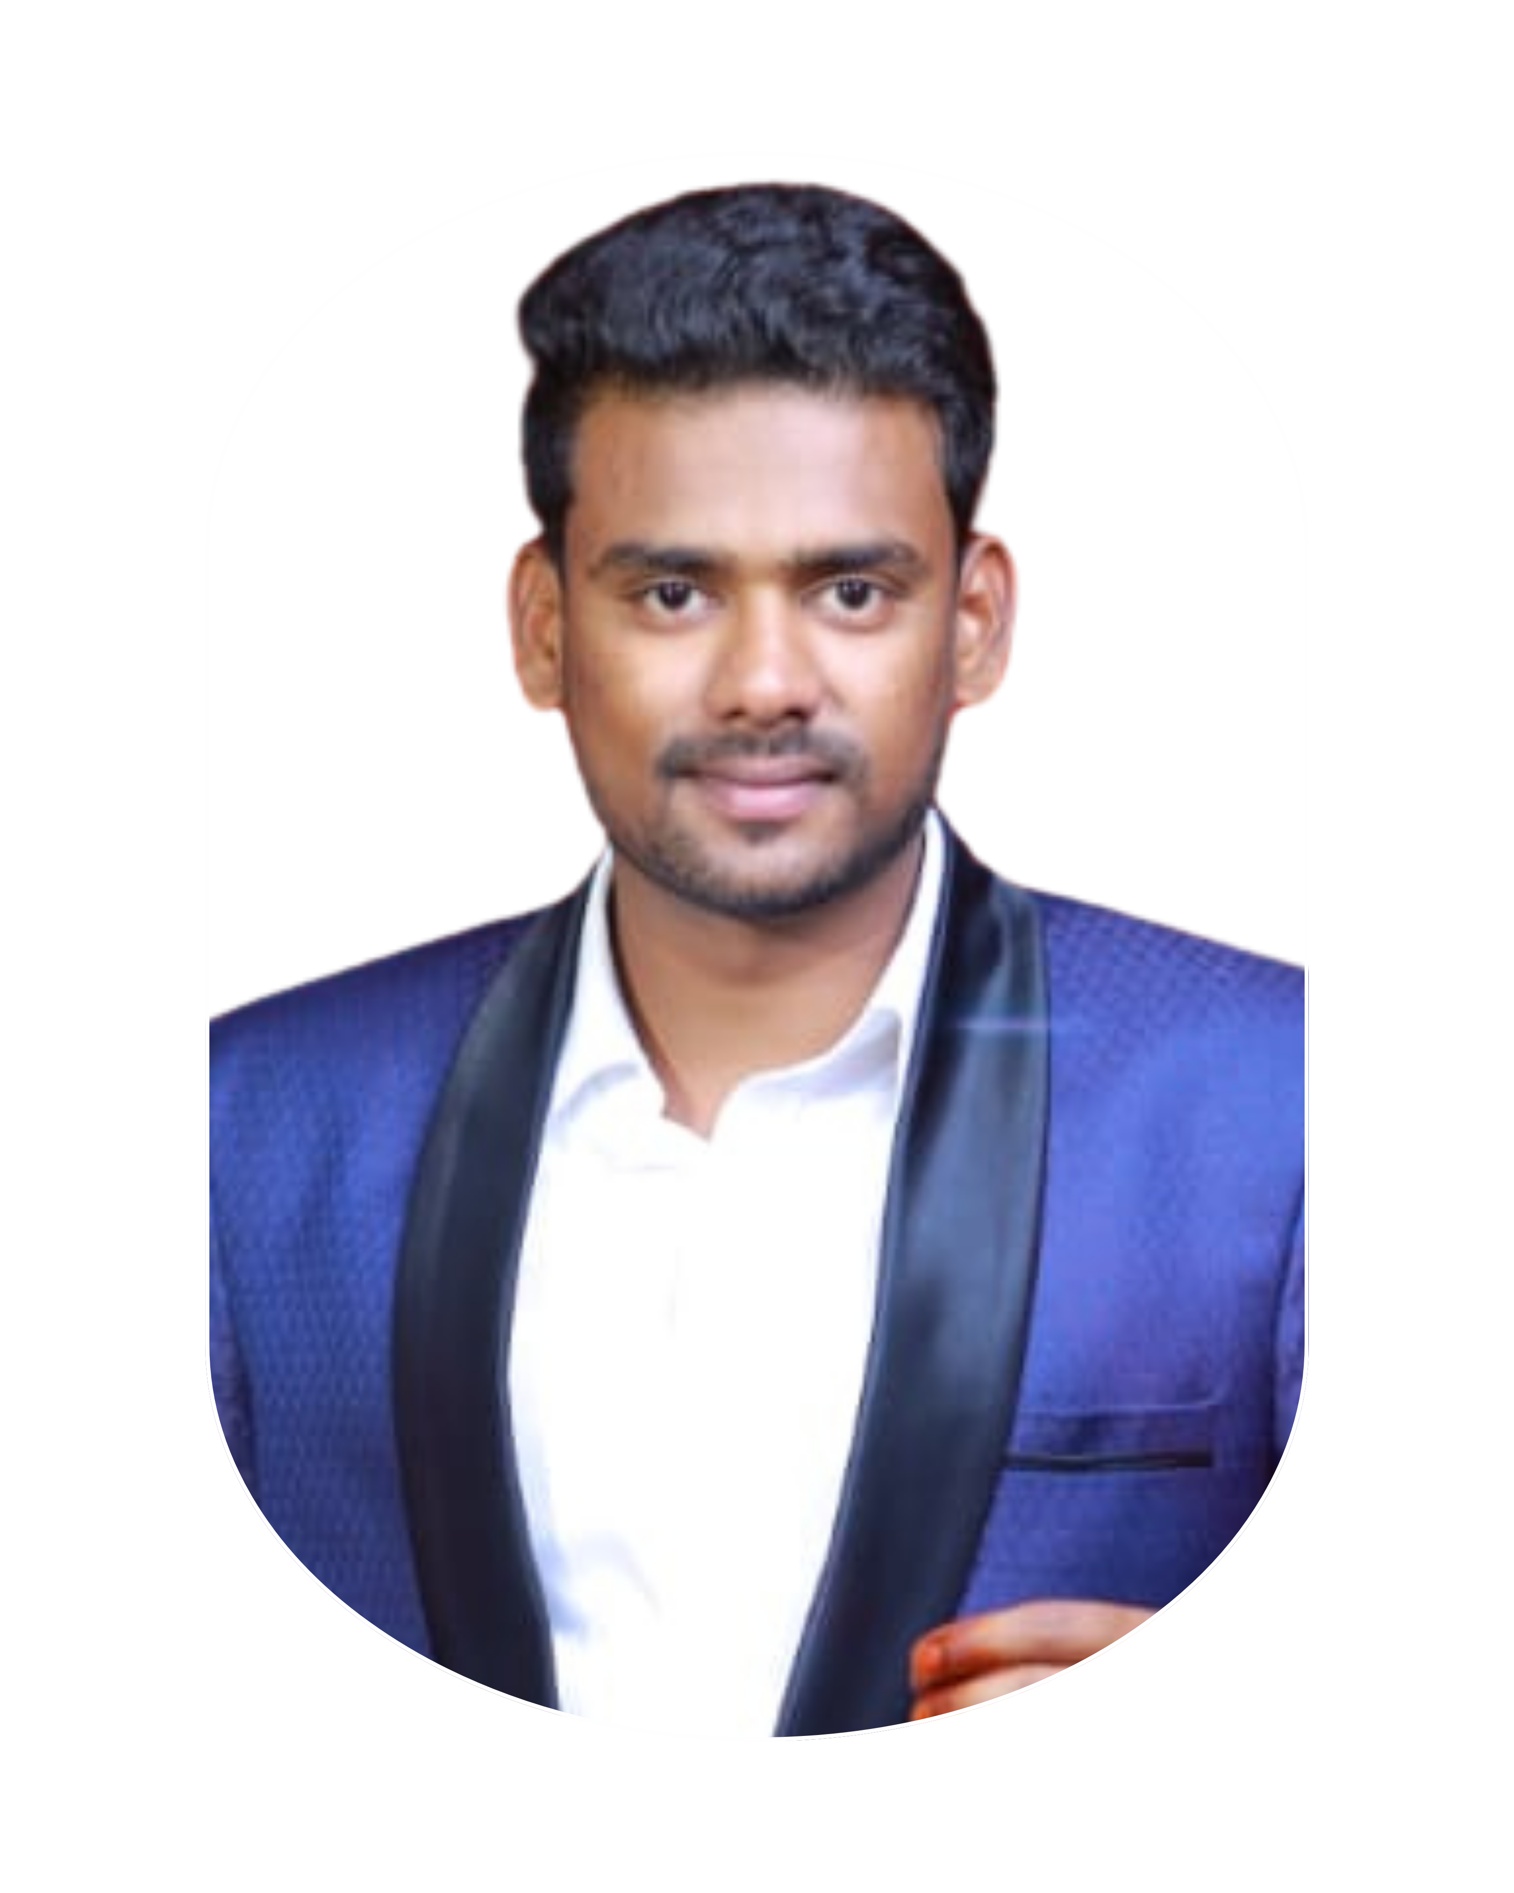
EXPPRESS CAR WASH
JC Shaanavas
📞 8220227001
📍 Perambalur

Slide 6

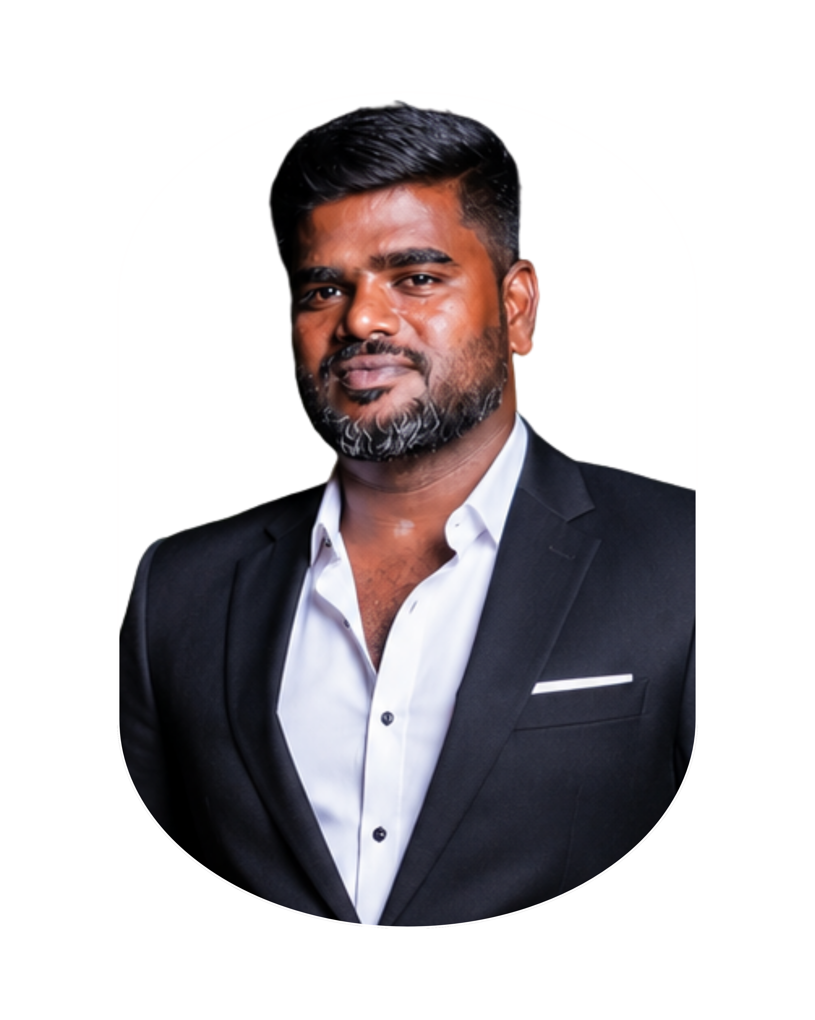
SRI NEELI ENTERPRISES - SECURITY SYSTEMS
JC Nizhal Ravi M
📞 8220821229
📍 Perambalur

Slide 7

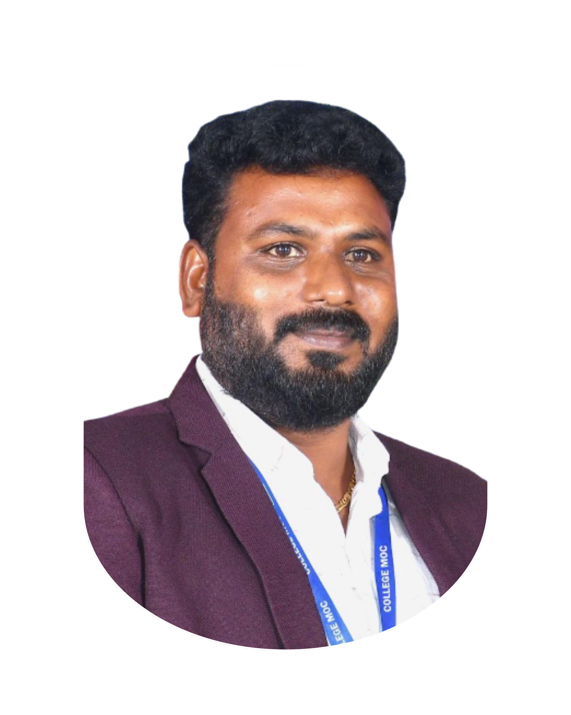
MAHENDRA OVERSEAS CONSULTING
JC Karthik S
📞 9600754477
📍 Perambalur

Slide 8

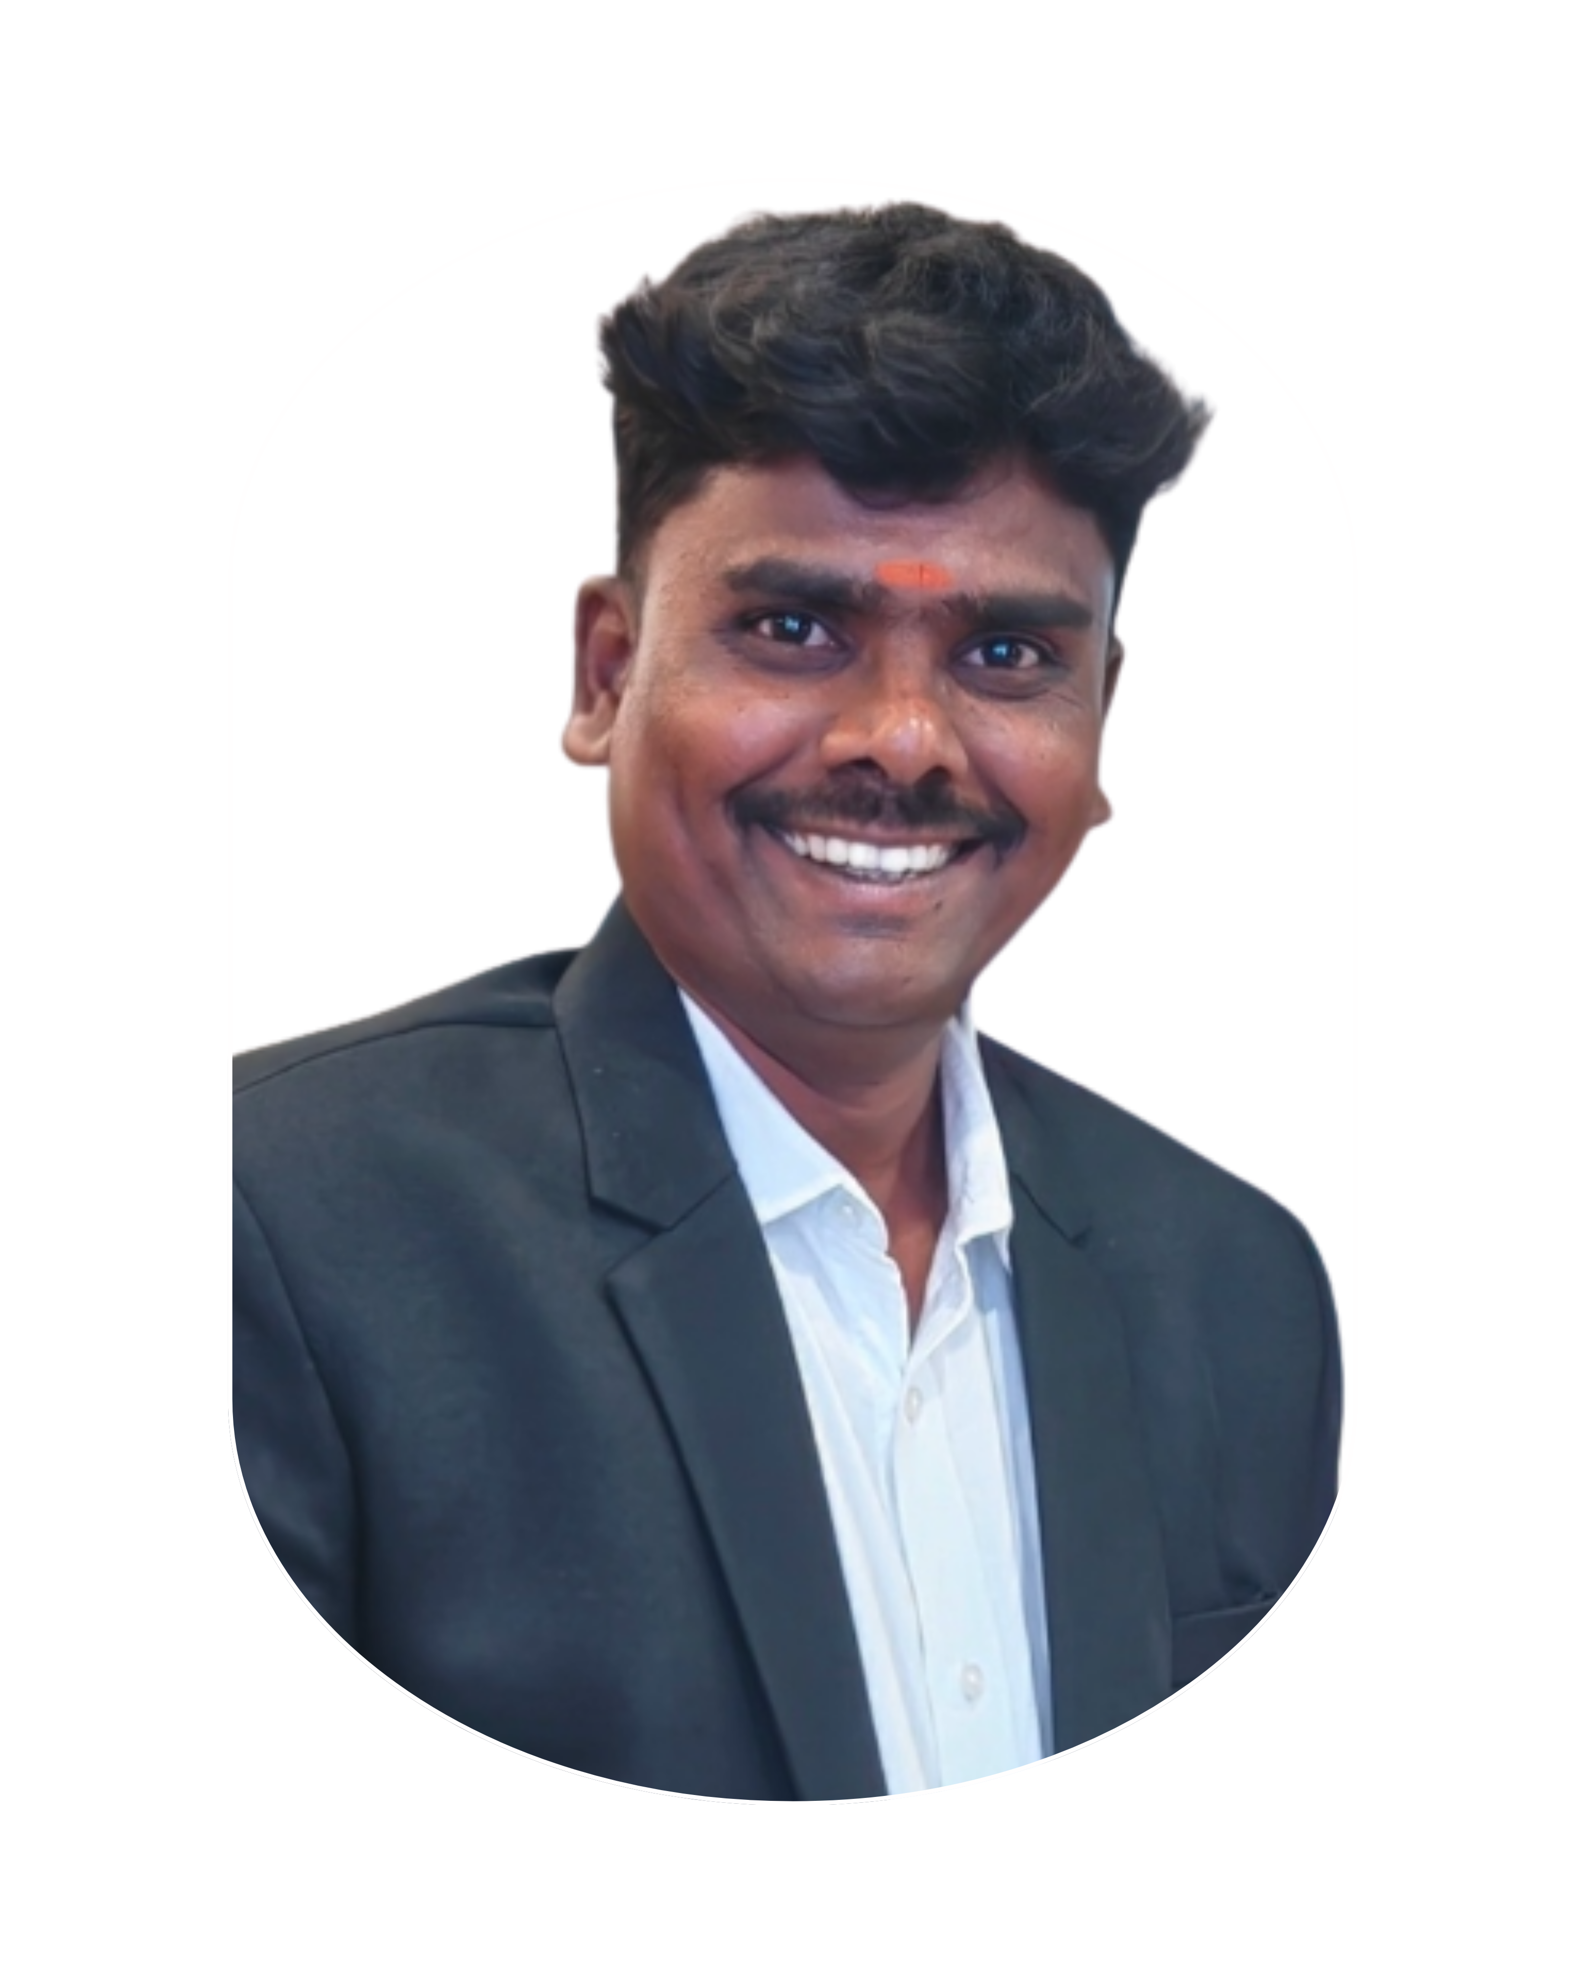
KKK CELL CITY
JC Kanagaraj K
📞 9751211787
📍 Perambalur

Slide 9

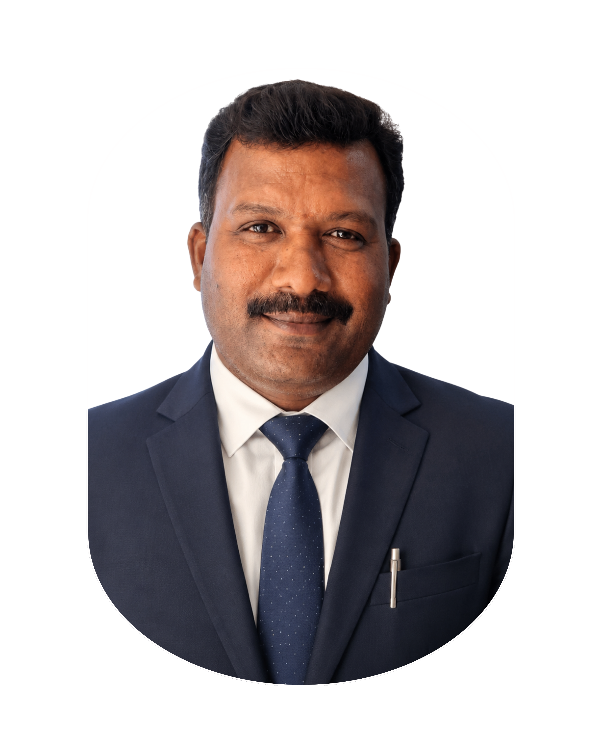
KASI MESS
JC Kasi Viswanathan
📞 9894087086
📍 Perambalur

Slide 10

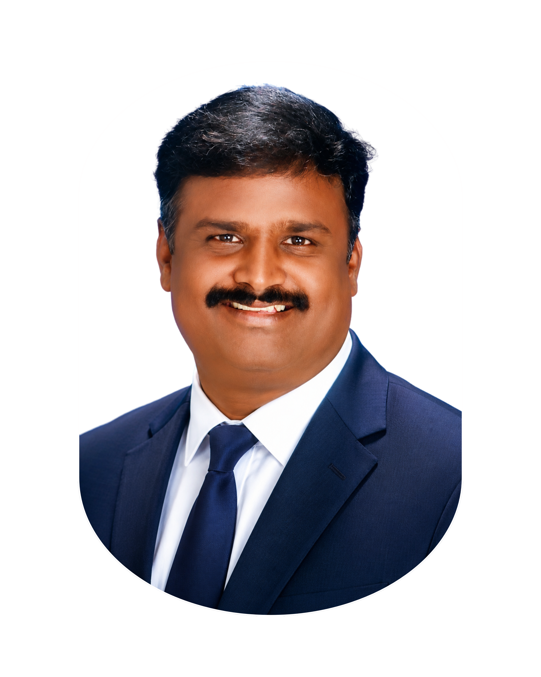
SHREE CONSTRUCTION
JC Senthil Kumar
📞 9842589055
📍 Perambalur

Slide 11

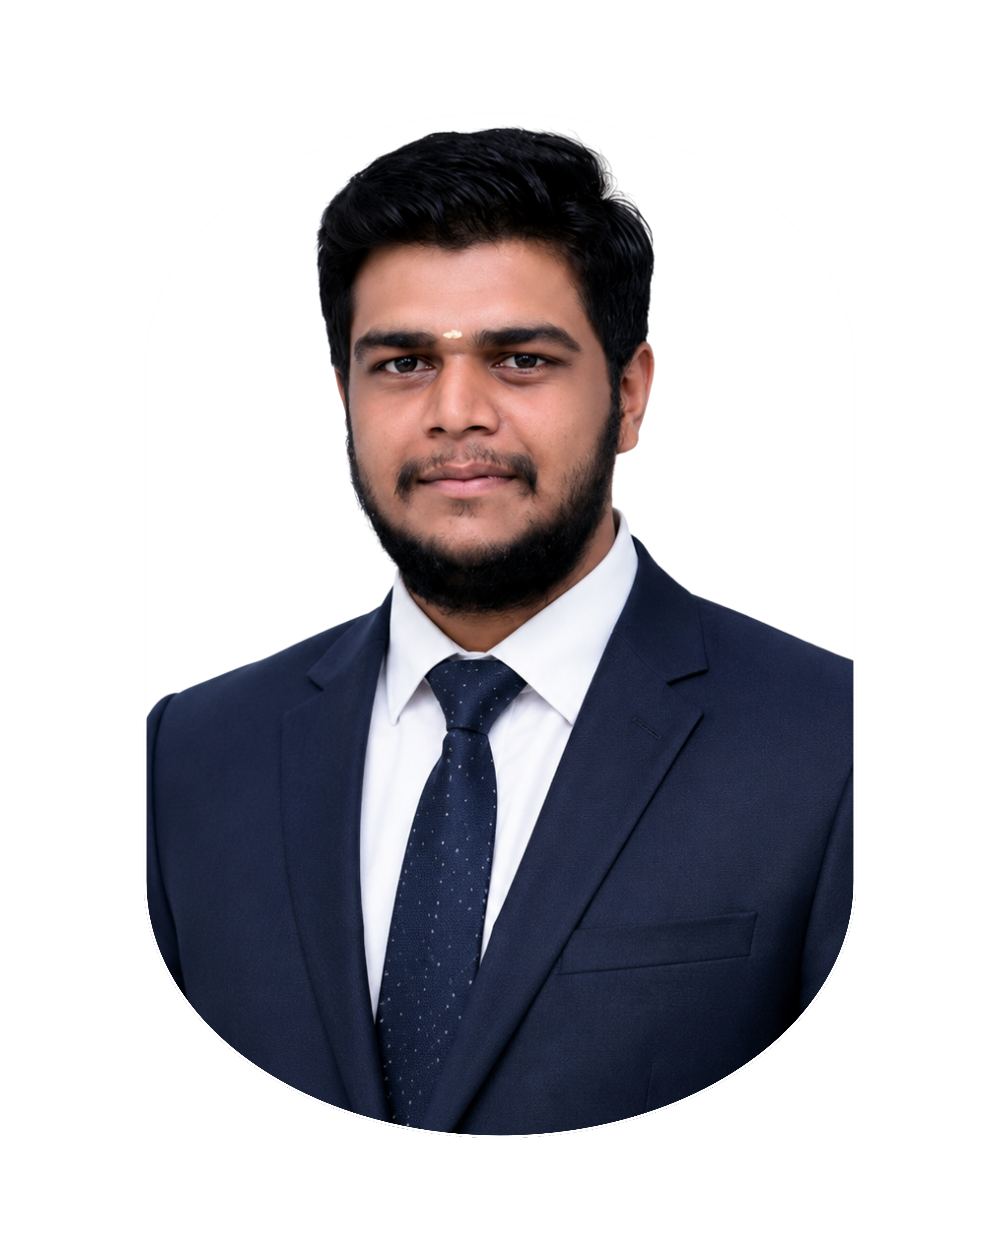
KAMADHENU CORPORATION
JC Aravind R
📞 9789228198
📍 Perambalur

Slide 12

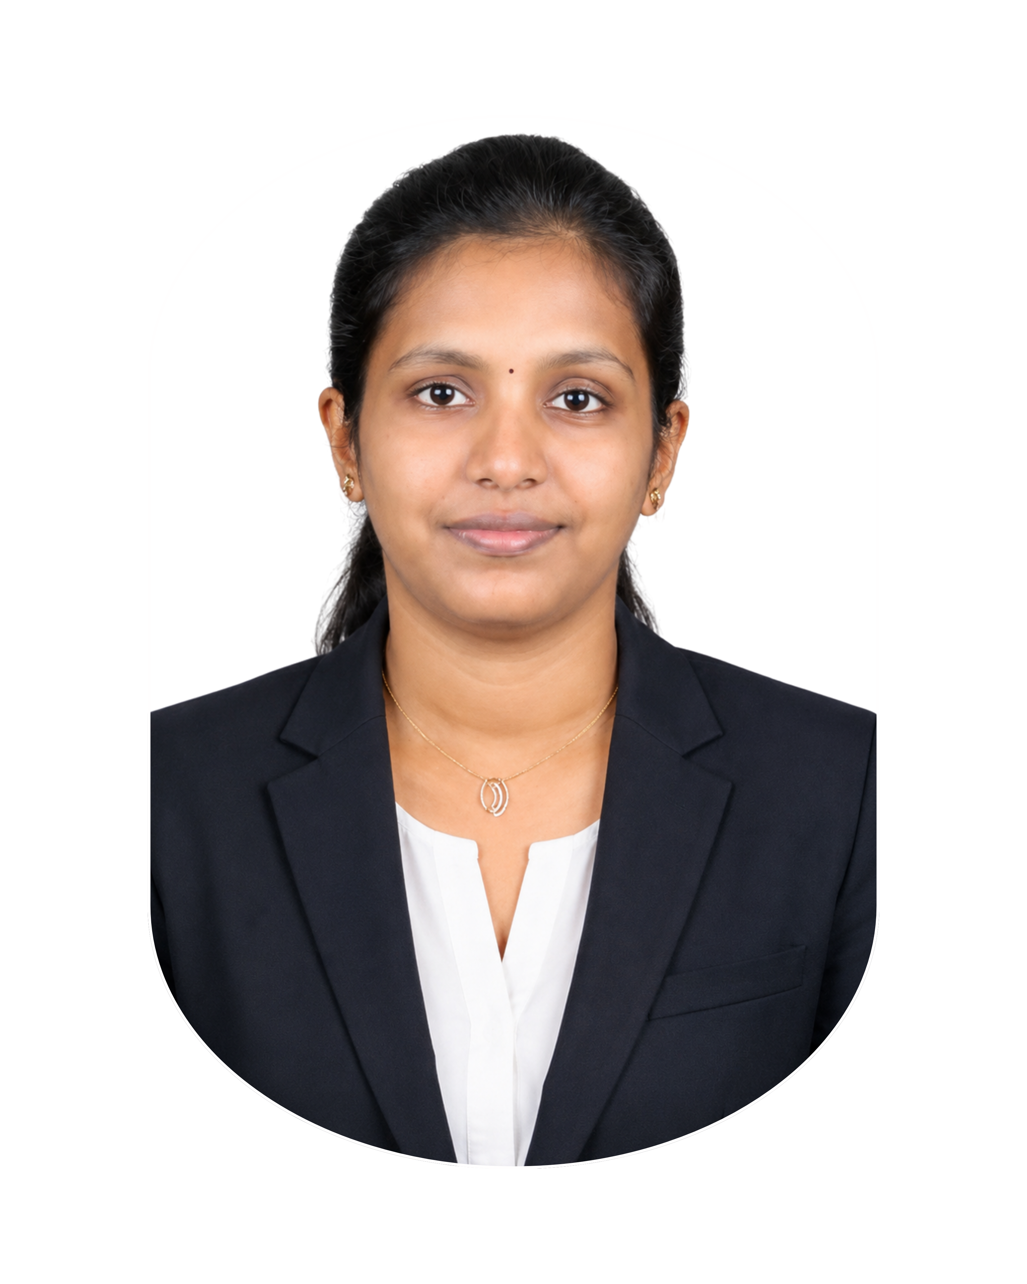
AMMAN BLUE METALS
JC Dhivya Baskar
📞 9894299142
📍 Perambalur

Slide 13

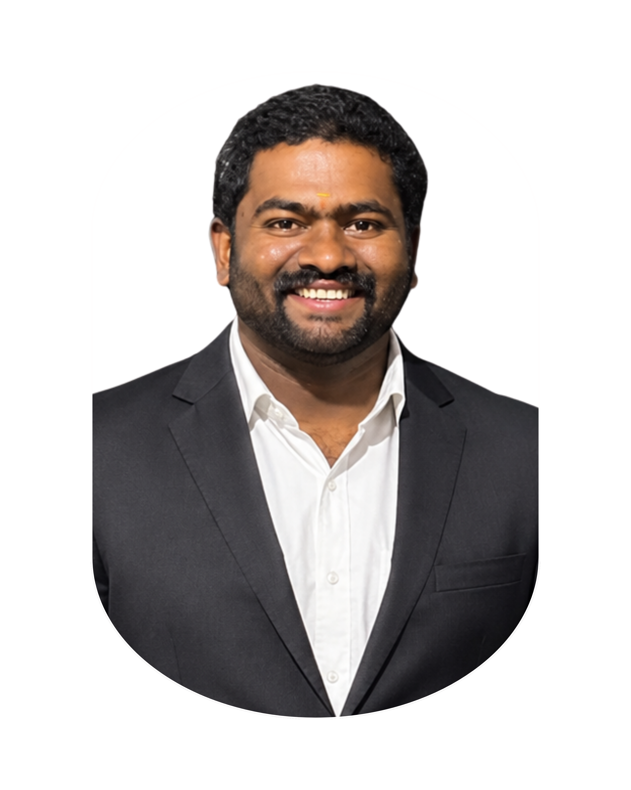
SRI SAI TILES AND PAINTS
JC Yogeshwar
📞 7010771011
📍 Perambalur

Slide 14

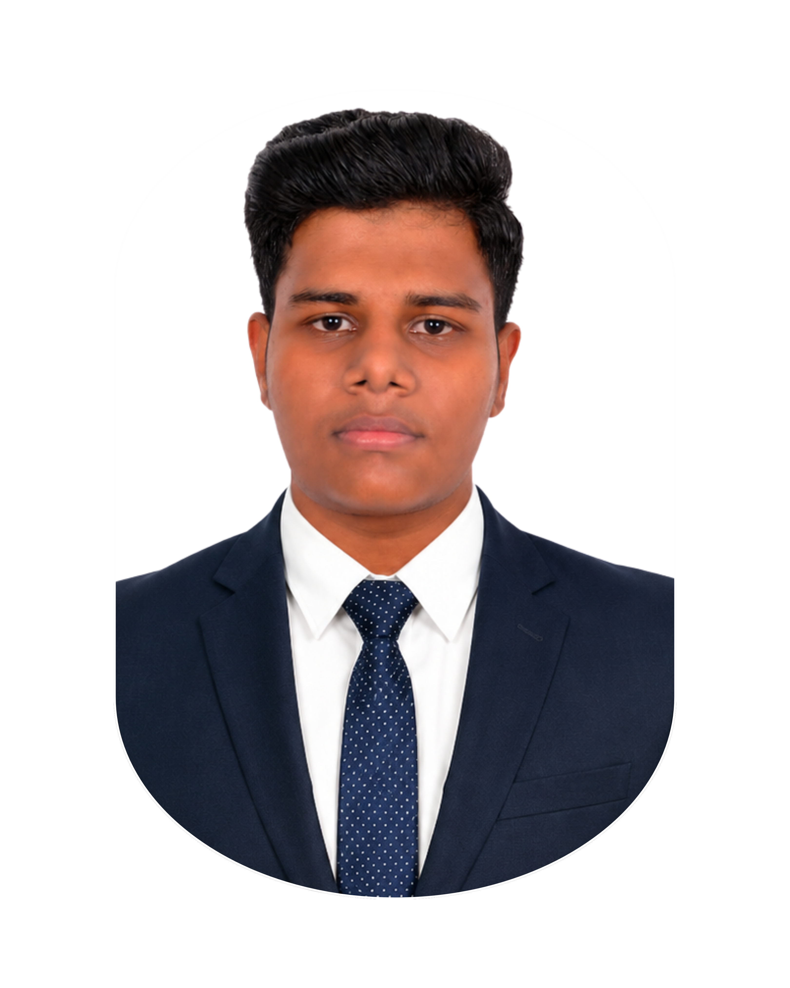
AGISHAA DRUG DISTRIBUTION
JC AGILESH Vijay
📞 9361477366
📍 Perambalur

Slide 15

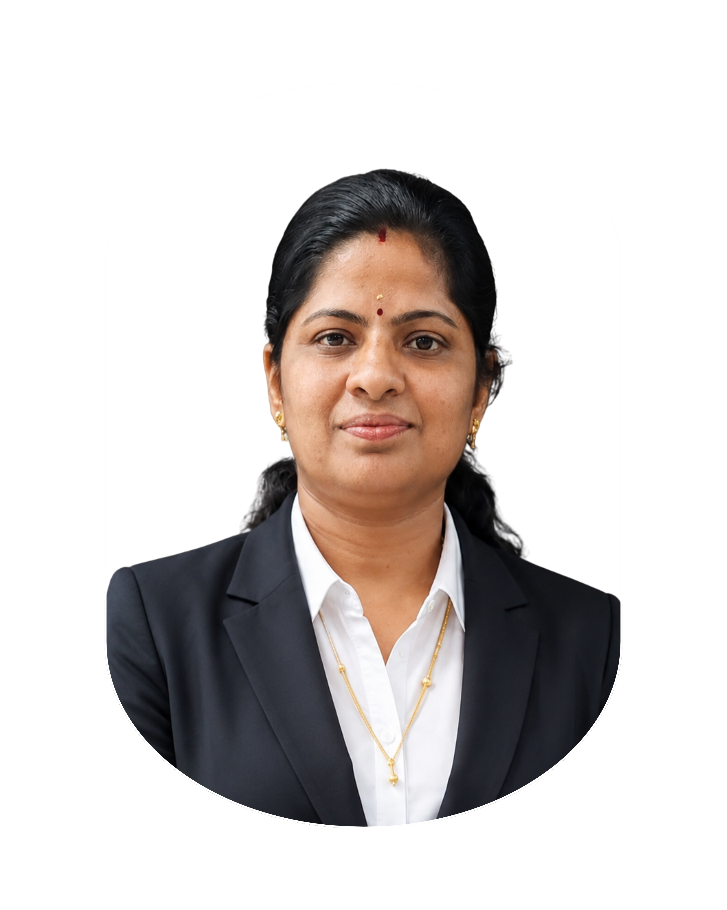
SRI NITHYA SILKS
JC Nithya Vinoth
📞 7708002800
📍 Perambalur

Slide 16

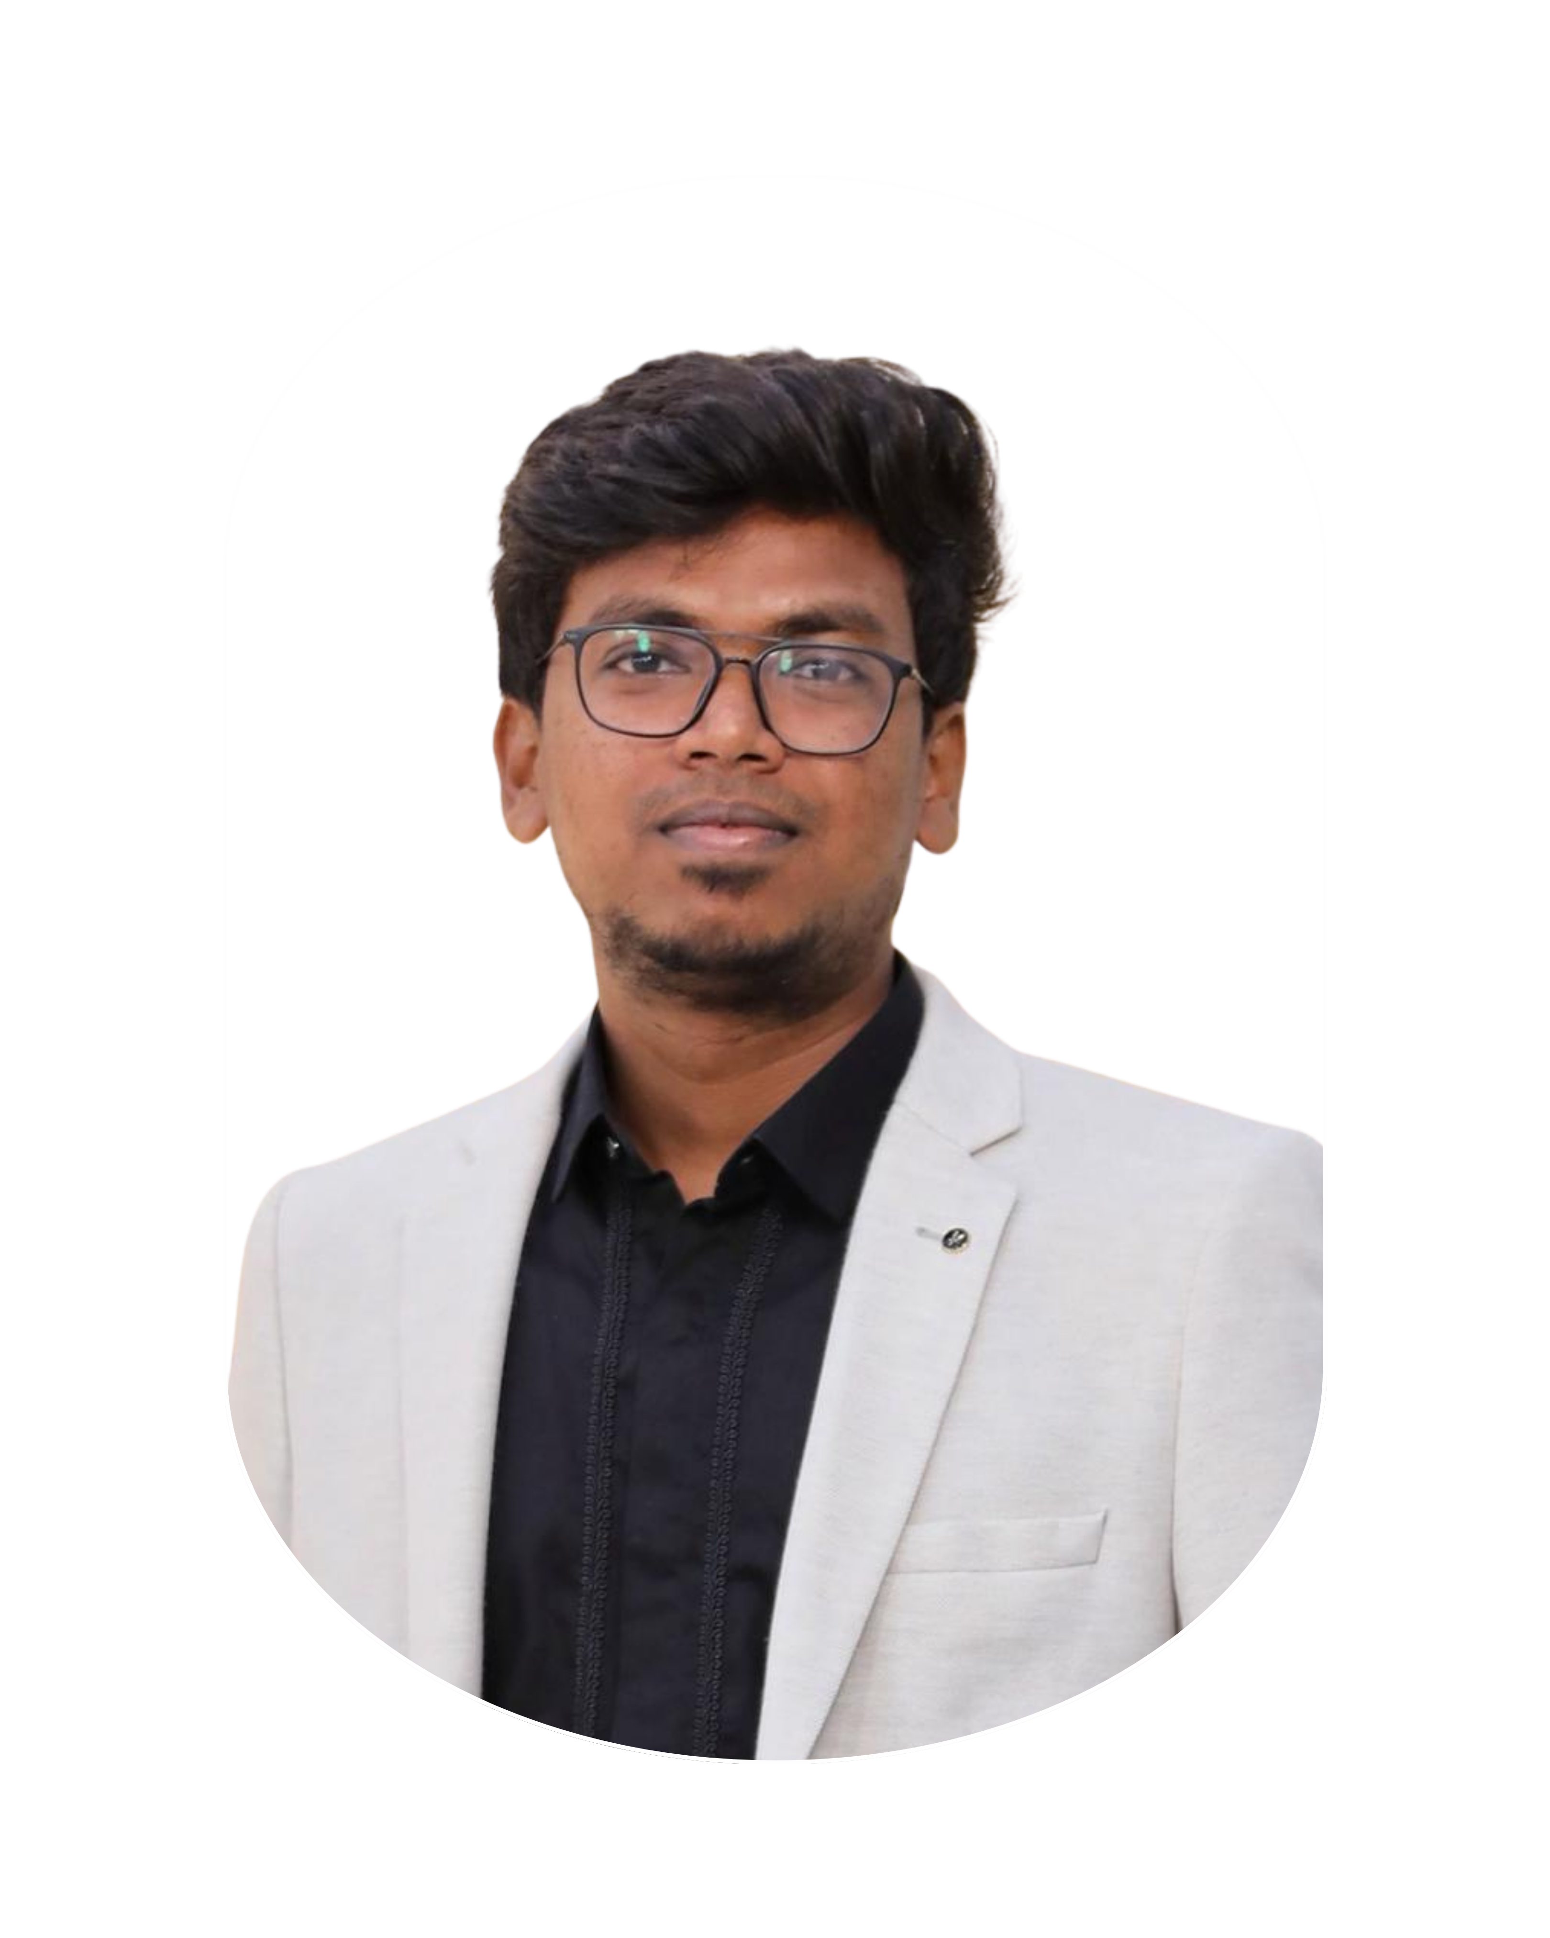
SCAR DESIGN STUDIO
JC Venkat Ramana
📞 9566885465
📍 Perambalur

Slide 17

SRI KALPANA BATTERY CENTER
JC Gurusaran
📞 6381798963
📍 Perambalur

Slide 18

TARGET INTERIORS
JC Raja
📞 9524842222
📍 Perambalur

Slide 19

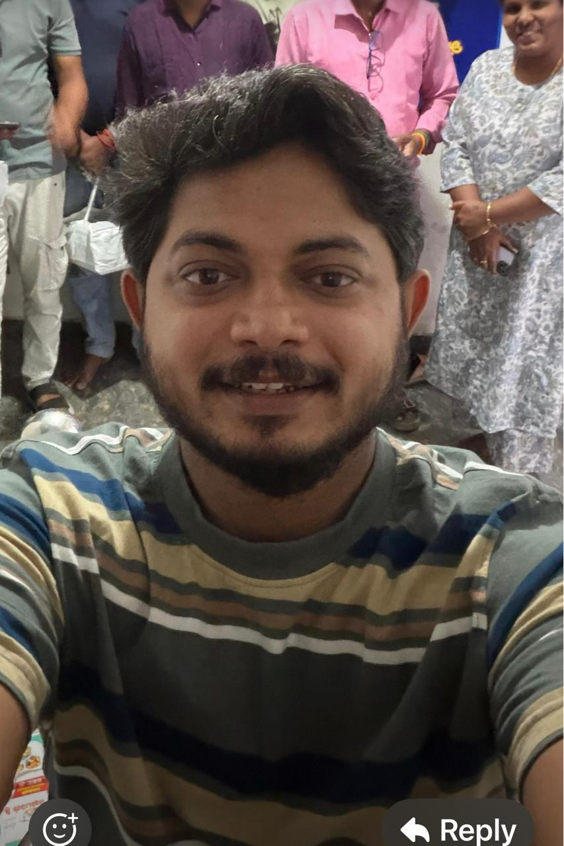
Offmap Holidays
Vipin R
📞 7788003351
📍 PERAMBALUR

Slide 20
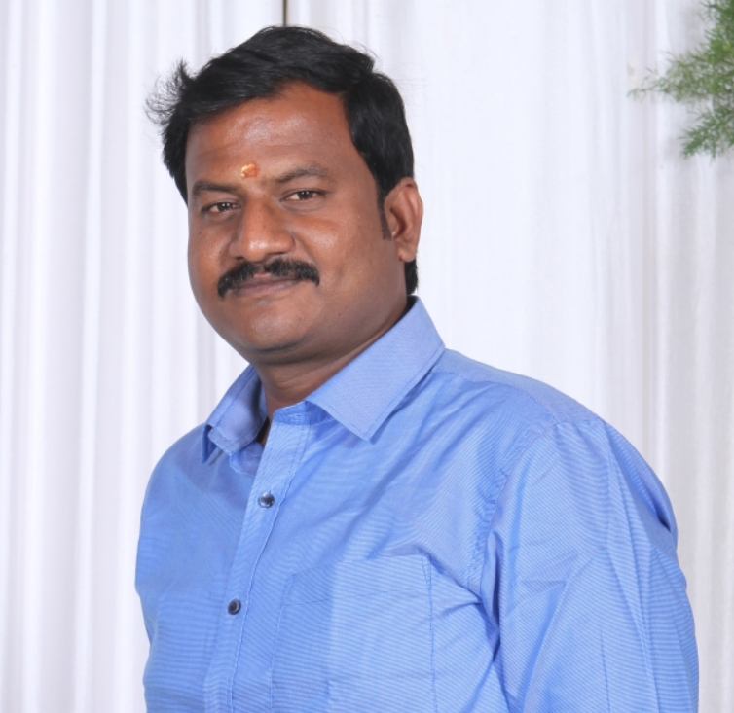
SAAS Computers
THIYAGU G
📞 9751377007
📍 PERAMBALUR

Slide 21
Sabari Smart Invest
SABARIGIRIVASAN
📞 8838192876
📍 PERAMBALUR

Slide 22
Vikee Photography
Vigneshwar
📞 9994554434
📍 PERAMBALUR

Slide 23
Wefsa Farmer Production Company
Mahendra M Manivasan
📞 9965737555
📍 Perambalur

